Slide 1

CRYPTO
20
Data Visualization project

Slide 2



Slide 3



Contents
00
Meet our team
05
Limitations
01
Introduction
06
Data Visualizations
02
Project Roadmap
07
Requirements
03
Data Warehousing
08
Questions
04
Flask
09
Thank you

Slide 4






Meet
Our Team
Aayushi Daliparthi
Smriti
Pawanpreet Dhillon

Slide 5


Crypto 20
Introduction
we aimed at revolutionizing data visualization through the creation of an interactive web page powered by data from Yahoo Finance.
Our mission is clear: to harness the vast potential of financial data, meticulously collected, cleansed, and transformed into a structured SQL database hosted in the cloud.
From there, we leverage the capabilities of JavaScript and the Flask framework to craft an engaging and intuitive web experience.

Slide 6


Project Roadmap
01
02
03
04
Yfinance - Data - SQL Collection/cleaning
Data storage- AWS (Cloud storage)
Data connection -Flask
Data Visualization- JSON/HTML

Slide 7

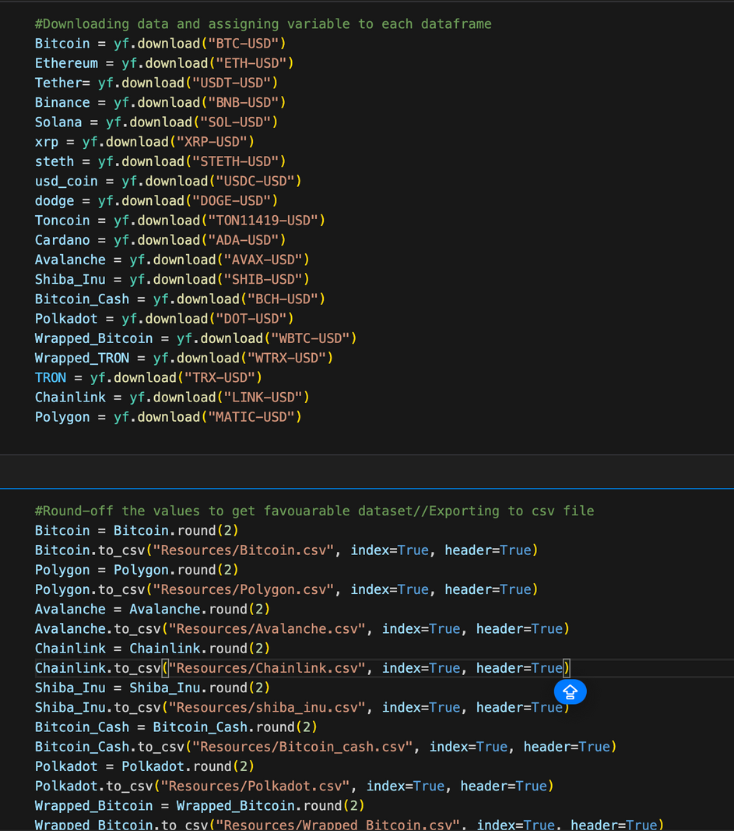

DATA COLLECTION
Our project focuses on leveraging the yfinance library to fetch
the most up-to-date market data directly from
Yahoo for crytocurrencies.
DATA MANIPULATION
Using Python and datetime library, we
retrieved the data by using tickers and
manipulated it to ensure accuracy and
relevance for our visualization.
DATA STORAGE
Once the data was processed, we converted
it into CSV files and stored it on our local
computers for easy access and further
analysis.

Slide 8
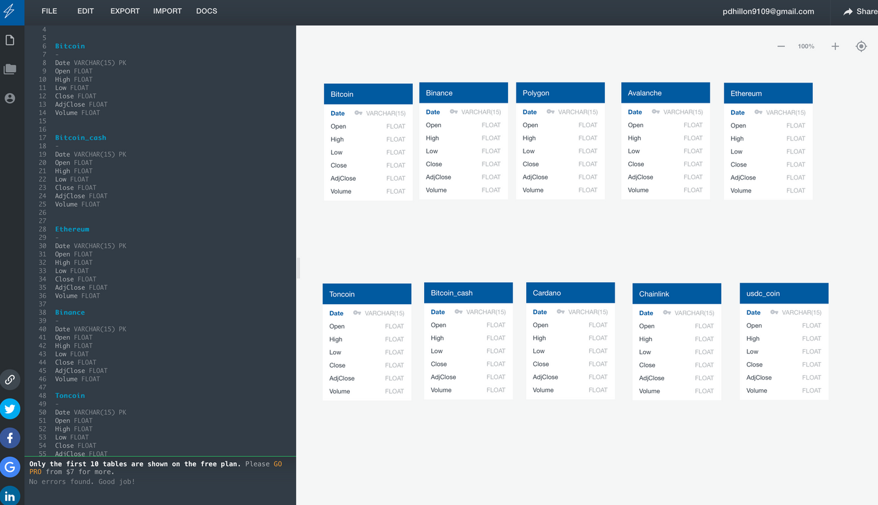
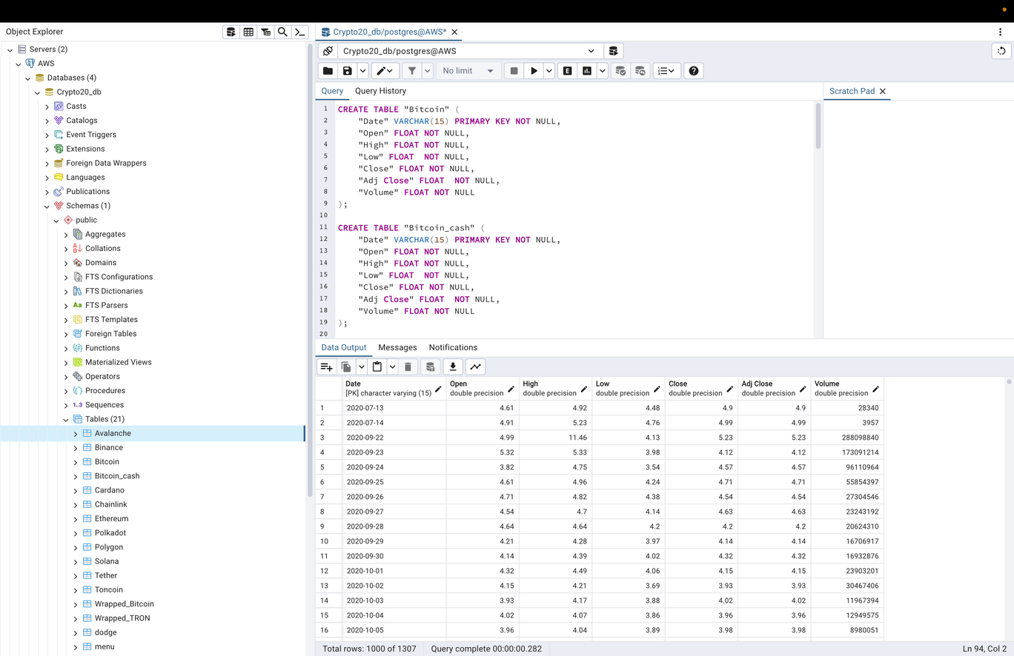

DATABASE DESIGN
Before uploading the data, we designed a proper database schema in pgAdmin,
ensuring it aligned with our data model and requirements. This involved defining
tables, columns, and indexes to optimize data retrieval and management.

Slide 9

AWS INTEGRATION
To facilitate collaboration and data sharing with other project stakeholders, we housed the data in AWS (Amazon Web Services).
VISUALIZATION
We used plotly to visualize the data in insightful and interactive ways, providing stakeholders with valuable insights and facilitating informed decision-making.

Slide 10


LIMITATIONS
Limited Cryptocurrency Coverage
Data Quality and Accuracy
No Customization Options
Limited API Support
Notes:
Limited Cryptocurrency Coverage: Yahoo Finance may not cover all cryptocurrencies. It typically focuses on the most popular ones like Bitcoin and Ethereum, but less well-known or newer cryptocurrencies may not be available on the platform.
Data Quality and Accuracy: The data provided by Yahoo Finance may not always be accurate or up-to-date. Cryptocurrency markets can be highly volatile, and delays in data updates can affect the reliability of the information.
Limited Historical Data: Yahoo Finance may only provide a limited amount of historical data for cryptocurrencies. This can be a drawback if you need extensive historical data for analysis or modeling purposes.
No Intraday Data: Unlike traditional stocks, Yahoo Finance may not offer intraday data for cryptocurrencies. This means you may only be able to access daily or periodic price data, which could limit certain types of analysis.
No Customization Options: Yahoo Finance may not provide advanced customization options for cryptocurrency data. For example, you may not be able to adjust the time intervals or select specific exchanges for data retrieval.
Lack of Fundamental Data: While Yahoo Finance offers some fundamental data for stocks, such as earnings and financial ratios, this type of information may not be available for cryptocurrencies. This limits the depth of analysis that can be performed using Yahoo Finance data alone.
Limited API Support: While Yahoo Finance does offer an API for accessing data, its support for cryptocurrency data may be limited compared to other financial data sources. This can restrict the flexibility and scalability of automated data retrieval and analysis workflows.

Slide 11


Crypto.20
Requirements
yfinance
AWS
Flask
plotly.express
Sql
Sqlalchemy
python
Javascript
pandas
HTML
Data Source: https://finance.yahoo.com/crypto/

Slide 12
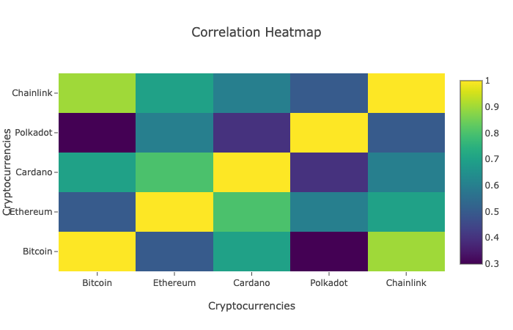
Correlation Heat map
Visualization 1
Notes:
The correlation heatmap depicts the correlation coefficients between different cryptocurrencies. In this example, the cryptocurrencies are represented on both the x-axis and y-axis, and the cells in the heatmap display the correlation coefficient between each pair of cryptocurrencies.
The correlation coefficient measures the strength and direction of the linear relationship between two variables. In the context of cryptocurrencies, the correlation heatmap can help visualize how the prices of different cryptocurrencies move relative to each other.
A correlation coefficient close to 1 indicates a strong positive correlation, meaning that the prices of the two cryptocurrencies tend to move in the same direction. A coefficient close to -1 indicates a strong negative correlation, meaning that the prices move in opposite directions. A coefficient close to 0 indicates little to no correlation.
By examining the heatmap, you can identify which cryptocurrencies have similar price movements and which ones have more independent movements. This information can be useful for portfolio diversification and risk management in cryptocurrency trading and investment.

Slide 13
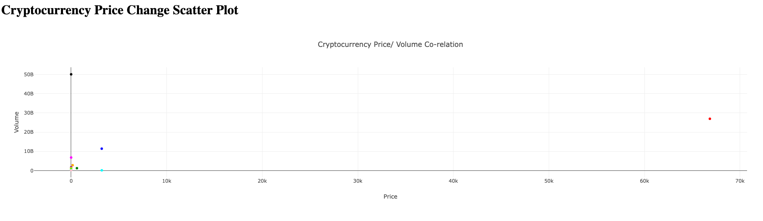
Scatter plot map
Visualization 2
Notes:
The correlation heatmap depicts the correlation coefficients between different cryptocurrencies. In this example, the cryptocurrencies are represented on both the x-axis and y-axis, and the cells in the heatmap display the correlation coefficient between each pair of cryptocurrencies.
The correlation coefficient measures the strength and direction of the linear relationship between two variables. In the context of cryptocurrencies, the correlation heatmap can help visualize how the prices of different cryptocurrencies move relative to each other.
A correlation coefficient close to 1 indicates a strong positive correlation, meaning that the prices of the two cryptocurrencies tend to move in the same direction. A coefficient close to -1 indicates a strong negative correlation, meaning that the prices move in opposite directions. A coefficient close to 0 indicates little to no correlation.
By examining the heatmap, you can identify which cryptocurrencies have similar price movements and which ones have more independent movements. This information can be useful for portfolio diversification and risk management in cryptocurrency trading and investment.

Slide 14
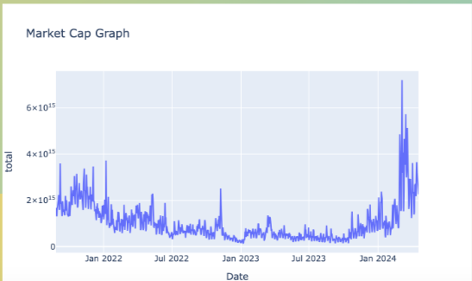
Market cap Graph
Visualization 3
Notes:
The correlation heatmap depicts the correlation coefficients between different cryptocurrencies. In this example, the cryptocurrencies are represented on both the x-axis and y-axis, and the cells in the heatmap display the correlation coefficient between each pair of cryptocurrencies.
The correlation coefficient measures the strength and direction of the linear relationship between two variables. In the context of cryptocurrencies, the correlation heatmap can help visualize how the prices of different cryptocurrencies move relative to each other.
A correlation coefficient close to 1 indicates a strong positive correlation, meaning that the prices of the two cryptocurrencies tend to move in the same direction. A coefficient close to -1 indicates a strong negative correlation, meaning that the prices move in opposite directions. A coefficient close to 0 indicates little to no correlation.
By examining the heatmap, you can identify which cryptocurrencies have similar price movements and which ones have more independent movements. This information can be useful for portfolio diversification and risk management in cryptocurrency trading and investment.

Slide 15
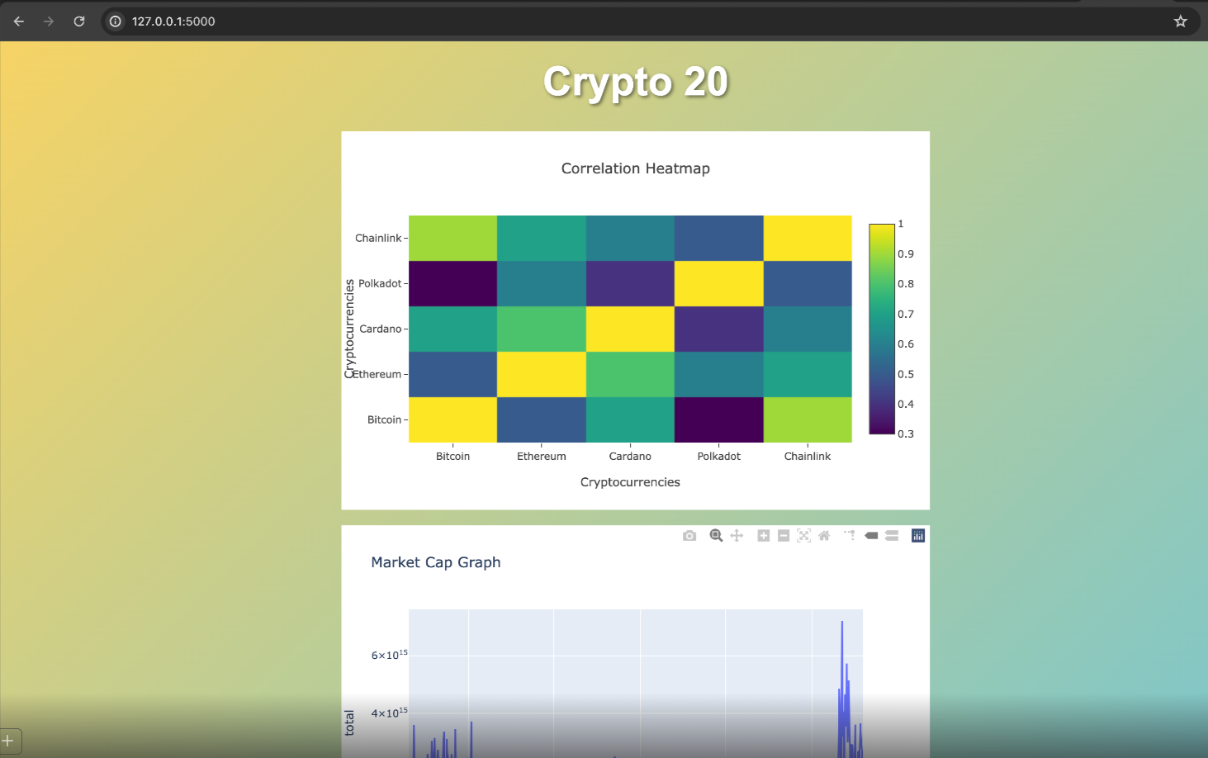
Flask : http://127.0.0.1:5000

Slide 16

QUESTIONS
?

Slide 17
THANK
YOU

